Slide 1



Slide 2
March 2026 A&P Monthly Meeting
Notes:
Good Morning, as you’re A&P chair and on behalf of the A&P executive team, I call our March 2026 monthly meeting to order. A&P Place Representatives and Committee Members, please use the link in the chat to mark your attendance. In accordance with Article IV, Section 1C, a quorum is established when 50% of elected members, not counting any of the chairs) are present. While our elected members note their attendance, we’ll cover some news and updates.

Slide 3


SAVE THE DATE
A&P PROFESSIONAL DEVELOPMENT DAY
APRIL 21, 2026
@
MELTON STUDENT CENTER
Presented by Professional Development and Welfare A&P Committees
Notes:
On behalf of our Welfare and Professional Development committees, we encourage A&P employees to join for the Professional Development Day, Tuesday, April 21st. Registration is required and space is limited. Please be on the look out for additional information coming soon.

Slide 4
Quorum?
Notes:
Deepa, can you please confirm that we have reached the necessary 50% to establish a quorum? The meeting minutes from our February 2026 meeting can be found on the A&P Assembly website. Do I have any amendments to the minutes? If none, the minutes are approved.

Slide 5
Committee Updates
Notes:
Our first committee update will be presented by our Welfare Committee. Laura, you have the floor.

Slide 6

Tiger Tips: Know your benefits
A&P Welfare committee

Slide 7

Healthy Relationships, Healthy Au!
The Alabama Healthy Marriage & Relationship Education Project
A&P Meeting
March 18, 2026

Slide 8
General Introduction
Strong & supportive relationships are one of the strongest predictors of optimal health and well-being¹
High rates of relationship dissolution persist²
Increased funding to implement & evaluate programs focused on improving relationship health³
¹Pinker, 2014; ²Rodrigues, Hall, & Fincham, 2005; ³Wadsworth & Markman, 2012
Notes:
We know that healthy relationships are essential for individual health and well-being
AND we also know that maintaining strong relationships is difficult – This is evidenced by high rates of relationship dissolution.
In response, federal and state funding has increased to support relational health.

Slide 9
The Basic Science Informed the Applied Science
Projects funded through the Department of Health & Human Services, Administration for Children & Families
The Alabama Healthy Marriage and Relationship Education (AHMRE) Project is a large-scale, federally funded, applied-research project at Auburn University (2003-2030)
Partnership among Auburn University and implementation partners at family service centers Alabama
Nearly 85,000 participants in Relationship Education (RE) classes since 2003 – 2025
Notes:
In 2003, the federal government began funding projects through the Department of Health & Human Services, Administration for Children & Families to support healthy marriages and relationships and to demonstrate the feasibility of implementing free, voluntary programs for couples.
Since then, Dr. Francesca Adler-Baeder, a professor in the department of Human Development and Family Science here at Auburn, established the Alabama Healthy Marriage & Relationship Education Project (AHMRE for short), and has successfully garnered over 50 million dollars in competitive federal funds over 20 years to provide and evaluate relationship education programs for youth and couples.
The initiative is a partnership between family life educators and researchers at Auburn University and implementation partners across the state of Alabama. Since its inception we have provided over 85,000 youth and adults with multi-session relationship education programming.

Slide 10
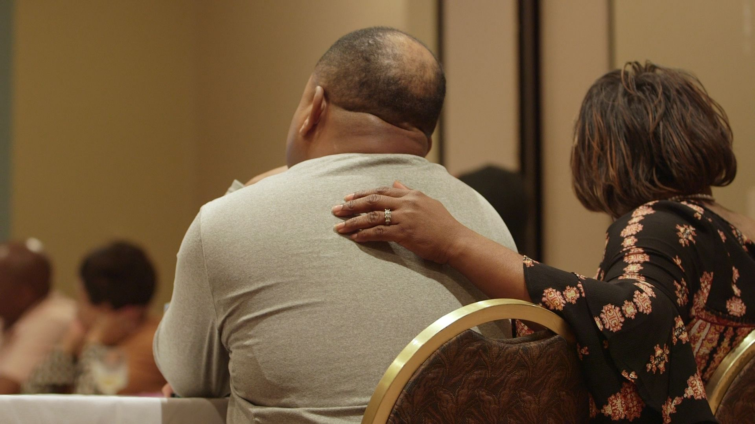



Understand how past and present experiences influence the body’s reaction to and regulation of emotions and behaviors.
Reinforce strategies you can practice to regulate your own physiological responses and actions in a relationship.
Enrich the experiences you share together that influence the direction and health of your relationship.
Notes:
The program we utilize is called ELEVATE.
It focuses on understanding and regulating emotions and behaviors by developing evidence-based skills.
It promotes caring and sharing behaviors to enhance the stability and quality of relationships – whether folks are dating or married.
We have had people who have been dating for 3 months to couples who have been married for 50 years participate.
Some people are concerned it might feel like therapy, but the classes are fun and educational.
In fact, a short video of couples that have taken our class on our website. Hear it from them!
VIDEO- https://www.youtube.com/watch?v=15CH3GRpTBg

Slide 11
Evidence of Program Efficacy & Effectiveness
Treatment effects are shown for participants in ELEVATE in a diverse sample of couples over a 1-year period in:
  Core relationship skills
  Couple satisfaction
  Mental health
  Sleep quality
  Family harmony
Our most recent randomized trial indicated couples benefit similarly regardless of whether they participate in the program in either a weekly or monthly format.
Notes:
We have also been able to provide evidence of efficacy.
Evidence from our randomized control trial indicates improvements for ELEVATE participants in core relationship skills, couple satisfaction, mental health, sleep quality, and harmony in the household over 1 year compared to the no program group who either stayed the same, or in the case of couple satisfaction declined over 1 year.
We were also able to conduct an additional study that indicates weekly and monthly formats are comparable in effectiveness. This and provided evidence of different and potentially more accessible offerings.

Slide 12

FREE
Class for couples
Notes:
Class enrollment is currently open and it will end when we are full. Begin registration at AlabamaMarriage.org

Slide 13

INTERESTED?
For Enrollment in Our Program-
AlabamaMarriage.org
marrfam@auburn.edu

Slide 14

Employee Benefits Supplemental Program Review (CY 2026)
Auburn University A&P Assembly March 18, 2026
Will Cone
Executive Director, Benefits & Payroll AU Human Resources

Slide 15


CY 2026 Employee Benefit Offerings
Retirement
  Statutory Pension: TRS
  Voluntary DC Plans, 403(b) and 457(b): Corebridge, Fidelity, Lincoln, TIAA
Health & Welfare
  Life Insurance: Term Life (Standard), Whole Life (Mass Mutual)
  Health Insurance: PPO and HDPH Plans, Blue Cross Blue Shield of Alabama
  Rx: Prime Therapeutics
  Healthy Tigers: Auburn University Pharmaceutical Care Center (AUPCC)
  Mental Health and EAP: Uprise
  Dental: Blue Cross Blue Shield of Alabama
  Vision: Superior Vision by MetLife
  Saving Accounts: HSA and FSA, HealthEquity
  Supplemental (Voluntary) Programs: Various, today’s discussion
Leave
  Policies: FMLA (Federal), PMFL (by State, where applicable)
  SCP: Self-administered by Auburn University
  LTD: The Standard
Other
  Please see Auburn HR for a full listing

Slide 16
Supplemental (Voluntary) Plans Overview
Auburn offers our employees a range of additional, voluntary programs beyond basic life and health insurance that are designed to provide additional protection or complement/supplement basic life and health offerings.
Eligibility: For full-time employees unless otherwise noted while certain plans allow an employee to add coverage for their spouse and/or children.
Premiums (Cost): Paid for by the employee (100%) via payroll deductions unless otherwise noted.
Administration: All claims are administered and adjudicated by a third
party, not Auburn University.
ACA and ERISA: For most coverages, ACA and ERISA rules do not apply to voluntary benefit offerings.
Auburn University reserves the right to add new plans, remove existing plans, alter the design of the plans, change the cost (premium), and switch administrators for these plans at any time in response to changing regulations, market conditions, vendors, and University needs.

Slide 17
Supplemental (Voluntary) Plans Listing
Accident Insurance
Additional Life and AD&D Insurance
Cancer Insurance
Critical Illness
Hospital Indemnity
Long-Term Disability (LTD) buy-up
Whole Life Insurance

Slide 18

Supplemental (Voluntary) Plans Listing
Enrollment
Benefit | Vendor | Action Needed
Basic Life Insurance | The Standard | None (Automatic)
Accident Insurance | The Standard | Enroll
Additional Life and AD&D Insurance | The Standard | Enroll (must be enrolled in basic life insurance)
Cancer Insurance | Colonial Life | Enroll
Critical Illness | The Standard | Enroll
Hospital Indemnity | The Standard | Enroll
Long-term Disability (LTD) buy-up | The Standard | Enroll
Whole Life Insurance | Mass Mutual | Enroll
Enrollment
Once an employee gains eligibility, such as when they are hired, change from student or part-time employee to full-time employee, or achieve one year of continuous service, they can elect in any of the University's voluntary programs.
Annual Enrollment
In most cases, employees can enroll, remove, or change their elected benefits during Annual Enrollment, i.e. Open Enrollment.
Qualifying Life Event (QLE)
In addition to when the are hired or become eligible and during Open Enrollment, employees can add, remove, or change their benefit elections if they experience a QLE in most cases.
Evidence of Insurability (EDI)
In most cases at the time when an employee can enroll or changes coverages, they can elect coverages up to the Guarantee Issue Amount, where applicable, without Evidence of Insurability (EDI) in most cases.

Slide 19
(Group) Accident Insurance
This coverage is designed to provide money directly to the covered individual and their family (if elected) to pay for out-of-pocket medical and non-medical expenses incurred due to an accident.
Administrator: The Standard
Enrollment: Employees who enroll in this coverage can add spouse and children to the plan.
Portability: If an employee leaves Auburn, they have the opportunity to continue this coverage at the same benefit level on a direct-pay basis.
Premium (cost) per pay period (CY 2026):
Pay Frequency | Employee Only | Plus Spouse | Plus Children | Plus Family
Biweekly | $3.19 | $5.08 | $8.03 | $9.48
Monthly | $6.91 | $11.00 | $13.07 | $20.53
9 Month | $4.61 | $7.33 | $8.71 | $13.69

Slide 20
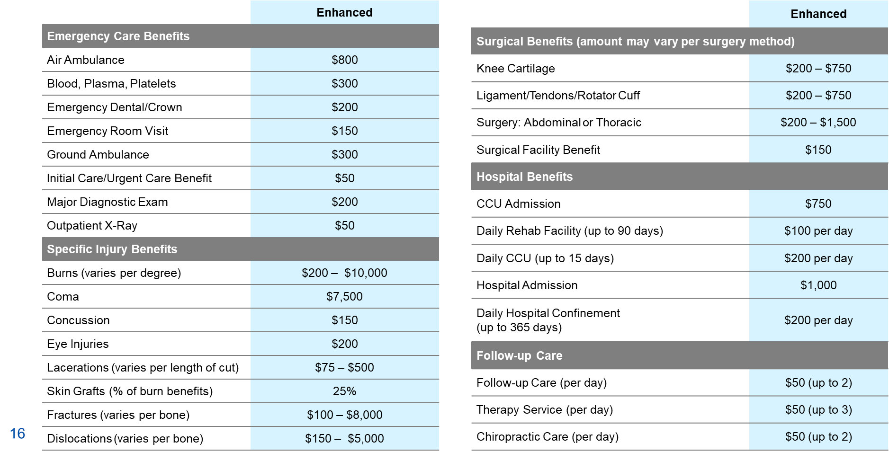
(Group) Accident Insurance
Schedule of Benefits (CY 2026)

Slide 21
(Group) Accident Insurance
Additional coverages and services
Youth Organized Sports Benefit pays an additional 25% of the total benefit for covered individuals under the age of 18 who are registered, there is no cap on the amount of the benefit provided.
Critical Care Unit (CCU) confinement and admission benefits pay in addition to daily hospital confinement benefits
Accidental Death & Dismemberment benefit of $50,000 for employees,
$25,000 for spouses, and $12,500 for children.
Annual Health Maintenance Screening of $50 per covered screening, including:
Abdominal aortic
aneurysm ultrasound
Ankle brachial index (ABI) screening for peripheral vascular disease
Biopsies for cancer
Bone density screening
Breast ultrasound
Cancer antigen 125 (CA 125) blood test for ovarian cancer
Cancer antigen 1503 (CA 15-3) for breast cancer
Carcinoembryonic antigen (CEA) blood test for colon cancer
Colonoscopy
Complete blood count (CBC)
Comprehensive metabolic panel (CMP)
Electrocardiogram (EKG)
Hemoccult stool analysis
Hemoglobin A1C
Human papillomavirus (HPV) vaccination
Lipid panel
Mammography
Pap smears or ThinPrep Pap test
Prostate-specific antigen (PSA) test
Stress test on a bicycle or treadmill
Mental health assessment
Novel infectious disease testing, like COVID-19

Slide 22
Additional Life and AD&D Insurance
Life and Accidental Death & Dismemberment (AD&D) is designed to provide funds to an employee’s family should the employee die in an accident (not an illness) or suffer a significant, permanent injury.
Eligible employees are automatically enrolled in the ‘basic’ plan, which is 100% paid for by Auburn, and have the opportunity to purchase additional coverage.
Coverage: Term life and AD&D insurance – the base and additional plans do not have a cash value at termination.
Administrator: The Standard.
Portability: If an employee leaves Auburn, they have the opportunity to continue this coverage at the same benefit level on a direct-pay basis.
Premium (cost) per pay period (CY 2026): Based on the amount of the benefit and age of the covered person and the rates are here.
Travel (domestic and international) Assistance: Provides emergency travel assistance while an employee (and their family if traveling with the employee) with respect to travel and medical emergencies. Service is provided by Assist America and additional information is listed here.
Support Services: Additional financial, wellbeing, etc. support is available to the insured (employee) and assigned beneficiary.

Slide 23
Additional Life and AD&D Insurance
Base (Group) Life Insurance
  Benefit: 1x Annual Earnings up to a Maximum of $35,000
  Cost: Employer (Auburn) paid, no cost to employee
Additional (voluntary) Life and AD&D Insurance
  Must be eligible and enrolled in the base (group) Life Insurance plan
  Benefit:
Covered | Benefit | Minimum | Maximum | Guaranteed Issue
Employee – Life | 1x to 5x Salary | 1x Salary | $450,000 | $450,000
Spouse - Life | Increments of $10,000 | $10,000 | $100,000 | $20,000
Children - Life | $5,000 or $10,000 | $5,000 | $10,000 | N/A
Employee - AD&D | 1x to 5x Salary | 1x Salary | $450,000 | $450,000
Spouse – AD&D | Increments of $10,000 | $10,000 | $100,000 | $20,000
Children – AD&D | $5,000 or $10,000 | $5,000 | $10,000 | N/A
Guaranteed Issue: For benefit amounts above the amount listed, medical underwriting may be required.

Slide 24
Cancer Insurance
This coverage is designed to provide money directly to the covered individual to pay for non-medical expenses incurred while being treated for cancer by a qualified healthcare provider. Two plans (levels) are offered. It is not health insurance.
Administrator: Colonial Life
Enrollment: New hires within their first 30 days of employment without evidence of insurability with a 12-month preexisting clause
Benefit: Various by cancer diagnosis, please go the AU Benefits page here for specific amounts
Premium (cost) per pay period (CY 2026):
Pay Frequency | Employee Level 2 | Employee Level 3 | Family Level 2 | Family Level 3
Biweekly | $6.39 | $10.41 | $10.66 | $17.31
Monthly | $13.85 | $22.55 | $23.10 | $37.50
9 Month | $9.23 | $15.03 | $15.40 | $25.00

Slide 25
Critical Illness
This coverage is designed to provide money directly to the covered individual and their families (if elected) to pay for out-of-pocket expenses should the employee or their family member be diagnosed with a covered illness. It is not health insurance.
Administrator: The Standard
Enrollment: New hires within their first 30 days of employment without evidence of
insurability and during Open Enrollment; can add spouse and children’s coverage
Benefit: Various by accident classification, please see next slide for details
Portability: If an employees leaves Auburn, they have the opportunity to continue the coverage on an individual basis for the same coverage levels, but the cost will be different
Exclusions: Act of war, injury as a result of committing a crime, consumption of illegal substances, certain elective procedures, suicide, etc.
Premium (cost) per pay period (CY 2026): Based on the benefit amount elected
and age of the covered person, rate information is here.

Slide 26
Critical Illness
Benefits
Covered | Benefit | Minimum | Maximum | Guaranteed Issue
Employee | Increments of $10,000 | $10,000 | $30,000 | N/A
Spouse | Increments of $5,000 | $5,000 | $15,000 | N/A
Children | Equal to Employee’s elected benefit |  |  | N/A
Additional Occurrence | Same as initial benefit and no wait period between diagnoses
Reoccurrence or prior illness | Same as initial benefit, 3-month treatment period per diagnosis required
Screening: | For annual health screening and 25 additional screenings (see optional life page for a list of covered screenings), receive a $50 cash payment per screening.
Covered Conditions at 100%
Cancer
End-Stage Renal (Kidney) Failure
Major Organ Transplant
Myocardial Infarction (Heart Attack)
Stroke
Coma
Paralysis
Loss of Sight, Hearing
Please contact The Standard for a full listing
or Speech
Advanced Multiple Sclerosis
Advanced Parkinson’s Disease
Advanced Alzheimer’s Disease
Amyotrophic Lateral Sclerosis
Benign Brain Tumor
Bone Marrow Transplant
Occupational Hepatitis
Occupational HIV

Slide 27
Hospital Indemnity
This coverage is designed to provide money directly to the covered individual and their families (if elected) to pay for out-of-pocket expenses should the employee or their family member be admitted to a hospital for medical care. It is not health insurance.
Administrator: The Standard
Portability: If an employee leaves Auburn, they have the opportunity to continue this coverage at the same benefit level on a direct-pay basis.
Premium (cost) per pay period (CY 2026):
Pay Frequency | Employee Only | Plus Spouse | Plus Children | Plus Family
Biweekly | $7.47 | $12.66 | $10.43 | $18.68
Monthly | $16.19 | $27.43 | $22.59 | $40.47
9-Month | $10.79 | $18.29 | $15.06 | $26.98

Slide 28
Hospital Indemnity
Benefits
Benefit Type | Benefit Amount
Hospital Admission: | $2,000 maximum per calendar year, 1 event per calendar year
and
Daily Hospital Confinement: | $200 maximum per day with a 15-day maximum per stay
Critical Care Unit (CCU) Admission: | $200 maximum per day with a 15-day maximum per stay
Newborn Converge: | Newborns are eligible for admission and confinement benefits if admitted to the NICU due to illness or injury
Benefit requires treatment by a physician or other advanced care provider in hospital (in-patient room or ER) for at least 20 consecutive hours.

Slide 29
Long-Term Disability (LTD) buy-up
This coverage is designed to provide additional income replacement above Auburn’s base Long-Term Disability (LTD) plan to the employee should they become disabled and are unable to work.
This benefit runs concurrently with the base LTD program, if elected, and after the short-term disability, i.e. Salary Continuation Plan (SCP), benefit has been exhausted.
While the benefit paid may run concurrently with other Leave programs, it is separate from FMLA, any applicable State-mandated paid leave programs, and Worker’s Compensation.
Coverage ceases when the employee is able to return to work or reaches Social Security Normal Retirement Age (SSNRA), which is between 62 and 65.
Administrator: The Standard
Eligibility
  New Hires: Active full-time non-student employees if most recent appointment period is
continuous for a minimum of one year (nine or twelve months as appropriate to the appointment).
  Existing Employees: A regular non-student employee of Auburn University in a position requiring appointment whose most recent employment period is for a minimum of nine months for faculty on a 9-month appointment, or 12 months for any other employee; or in a position not requiring an appointment.
Portability: This coverage is not portable.
Premium (cost) per pay period (CY 2026): $0.09 per $100 of monthly covered
earnings prorated per pay frequency.

Slide 30
Long-Term Disability (LTD) buy-up
Benefits
Employee Classification | Monthly Cost (CY 2026, $0.09 per $100 of monthly pay) | Benefit (as a percentage of annual pay)
 |  | Benefit | Monthly Minimum | Monthly Maximum | Waiting Period
Base Plan: Active, full-time, non-student employees
Less than 1-year of continuous service | 100% Employee Paid | 60% | 10% or $100 | $7,000 | 180 Days
Then
More than 1-year of continuous service | 100% Employer Paid | 60% | $100 | Same | 180 Days
And
Buy-Up | 100% Employee Paid | + 10% | Same | Same | 180 Days
One year of service may be qual to 12-months or 9-months, depending on role.
The benefit paid is taxable to the employee.
Preexisting conditions for the LTD Buy-Up are the same as the main LTD plan.
If there is an active LTD claim and claim has been active for 180 days or more, there is a survivor's benefits whereby the designated survivor would receive the remainder of the benefit should the insured pass.

Slide 31
Whole Life Insurance
Whole life insurance is designed to provide employees who elects this coverage an additional benefit payable to their designated beneficiary(s) should they die.
Unlike Term Life Insurance, a Whole Life Insurance plan can be terminated.
i.e. ‘Cashed out’ before the covered individual dies and the ‘cash balance’
of the plan is payable to the insured.
Coverage is available in increments of $10,000 up to a maximum benefit of
$150,000 without Evidence of Insurability (EDI). Eligible spouses and children can be covered for $25,000. Coverage automatically ends at age 100.
Administrator: Mass Mutual.
Eligibility: Active, full-time, non-student employees with 12 months of continuous service are eligible.
Portability: If an employee leaves Auburn, they have the opportunity to continue
this coverage at the same benefit level on a direct-pay basis.
Premium (cost) per pay period (CY 2026): Based on the amount of the benefit and age of the covered person.
For rates and termination value information, please go here.

Slide 32
QUESTIONS & ANSWERS

Slide 33


Slide 34
2026 A&P Nominations
Nominations & Elections Committee
Notes:
Our next committee update comes from our Nominations & Elections Chair, Naomi. Naomi, you have the floor.

Slide 35
2026 A&P Nomination Timeline
Executive Committee
2/12/26-3/18/26: Nomination Period
3/19/2026: Announce Nominees via email to A&P Assembly
Place Representatives
3/25/2026-4/21/2026: Nomination Period
4/22/2026: Announce Nominees
Committees
4/20/2026-5/17/2026: Nomination Period
~5/20/2026: Submit proposed committee assignments to A&P Assembly for review
~4/3/2026: Assembly vote during special meeting
5/1/2026: Open Voting, closes on 5/1/2026 at 4:45pm (notify nominees of results)
6/15/2026: Submit final committee assignments to A&P Executive Committee
5/20/2026: Announce new Place Representatives

Slide 36
Executive Committee positions –
Chair-Elect
  Eligibility: Must have served on the Executive Committee for one full year, within the last 5 years
  Time Commitment: 3-year commitment (chair-elect, chair, past-chair)
Secretary:
  Eligibility: Must have served on the A&P Assembly for one full year, within the last 5 years
  Time Commitment: 1-year commitment; 4-5 hours/month
At-Large:
  Eligibility: Must have served on the A&P Assembly for one full year, within the last 5 years
  Time Commitment: 1-year commitment; 2-3 hours/month

Slide 37
PLACE REPRESENTATIVE positions –
Nominations open on march 25th
Place 2 (Athletics)
Place 4 (Provost & Senior VP Academic Affairs)
Place 5 (Agriculture Experiment Station & ACES)
Place 10 (College of Education, & College of Liberal Arts)
Place 12 (College of Veterinary Medicine)
Place 13 (College of Human Sciences, College of Nursing, College of Pharmacy)
Place 14 (College of Business, College of Architecture Design & Construction, & College of Forestry Wildlife Environment)
Place 15 (College of Agriculture)
Place 18 (Graduate Studies, VP for Enrollment Management, AVP Administrative Effectiveness, Library)

Slide 38


Why serve?
Make a meaningful impact on campus
Strengthen the voice of A&P employees
Build connections across the university
Develop leadership and governance experience
Stay informed on key initiatives
Represent colleagues and elevate their needs
Grow professionally in a supportive team
Help shape future A&P priorities

Slide 39
Contact us
APNECOM@auburn.edu
Notes:
Thank you, Naomi.

Slide 40
Dr. Sean A. Forbes – Chair, Administrator Evaluation Committee for the University Senate
Notes:
Our next presenter is Dr. Sean Forbes. He is serving as Chair for Administrator Evaluation Committee for the University Senate. Dr. Forbes, you have the floor.

Slide 41
University Senate
Administrator Evaluation Committee
University Senate
Administrator Evaluation Committee
Committee is responsible for oversight of the annual evaluation of academic deans and department chairs/heads by faculty and staff of their respective units
[NOTE: Separate evaluation from Provost’s 3-5 Year Administrator Review process]
Administrator Review Questionnaire (ARQ) used to collect input from faculty and staff
Adopted in 2004; never been substantively revised (minor edits in 2022)
Notable concerns—
-1 instrument for 2 roles
- Vague & overlapping items
-Over emphasizes admin functions, under emphasizes relational approach, culture shaping and strategic vision
-Low response rates

Slide 42
University Senate
Administrator Evaluation Committee
University Senate
Administrator Evaluation Committee
End of 2024-25 academic year—Senate Leadership charged committee with revising ARQ; necessitates pausing evaluation process for 2025-26 academic year to focus on revising ARQ
Goal of ARQ revision is to develop separate questionnaires for deans and department chairs/heads that reflect the competencies relevant to the scope/authority of each
Input on ARQ revision will be solicited from faculty and staff in all academic units in April.

Slide 43
Dr. Jennifer Adams – VP of Public Affairs, Communications & Marketing
Notes:
Our last presenter for today is Dr. Jennifer Adams, VP of Public Affairs, Communication and Marketing. Dr. Adams, the floor is yours.

Slide 44

Office of Communications & Marketing
A&P Presentation

Slide 45
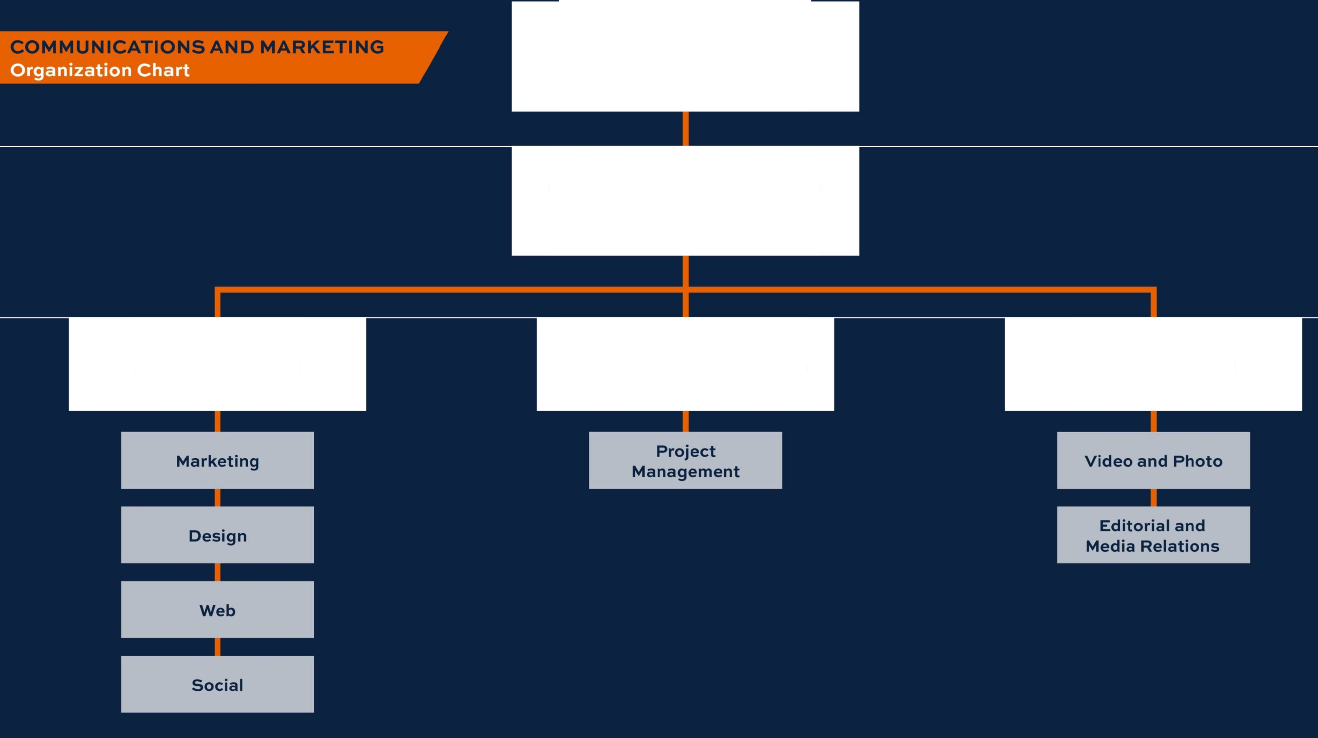
The Office of the President
Jennifer Wood Adams, Ph.D.
Vice President of Public Affairs,
Communications & Marketing
Colleen Bourdeau
Associate Vice President
of Marketing
Brooke Bailey
Director, Integrated Communications
and Institutional Response
Megan Burmester
Assistant Vice President
of Communications

Slide 46


Auburn News
Published every Monday
Internal newsletter for faculty & staff
Strive for balanced coverage of all colleges & units

Slide 47
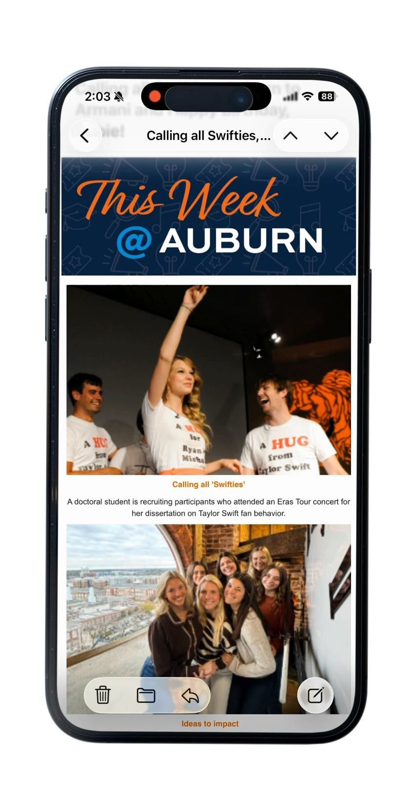
This Week @ Auburn
Published on Thursdays
Focus on:
  Events
  Photo carousels
  Videos
  Stories relevant to students

Slide 48


Externally facing
Institutional storytelling
  Align with mission & strategic plan
  Elevate national reputation

Slide 49



Slide 50


Refreshed OCM Website
Logos
Email signature generator
Stationery
Nametags
Image library

Slide 51


Templates & Toolkits
Microsoft Word and PowerPoint integration
Toolkits
  Conference Toolkit
  America 250

Slide 52
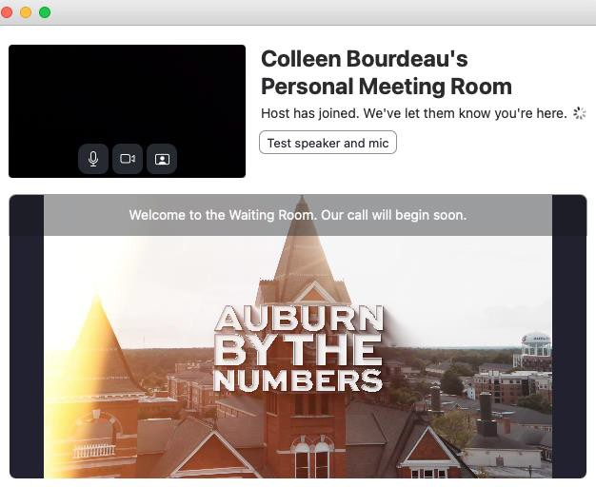
Zoom
Branded waiting room video

Slide 53


Research videos for AP distribution
Video can be used by AP members:
  TV
  Radio
  Written Article
  Digital/Social Video

Slide 54


Media Training
Workshops launch Fall 2026
Practical guidance
  What makes a story newsworthy
  How to communicate complex research & key messages clearly
  How to prepare for an interview
Research Communications Fellows

Slide 55



Slide 56

Thank you
auburn.edu

